Slide 1
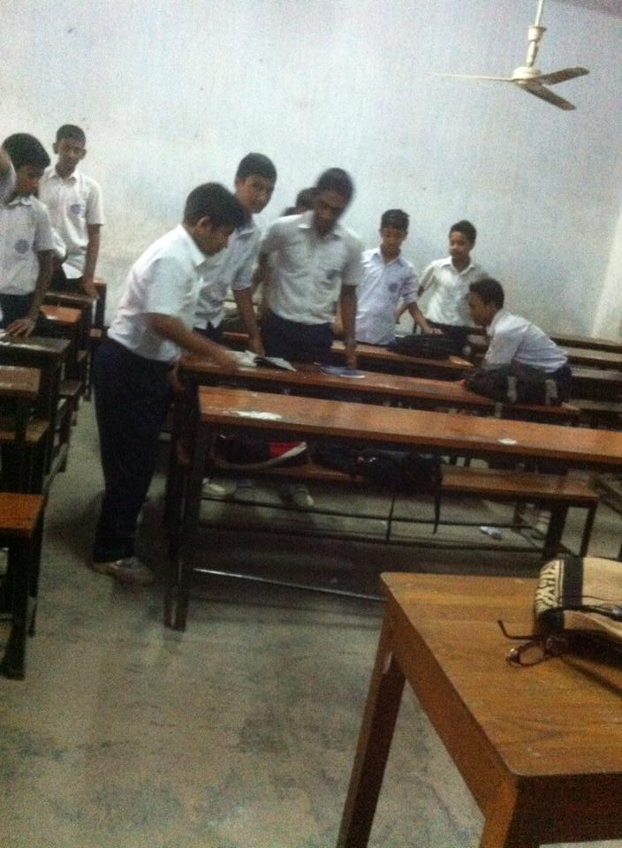
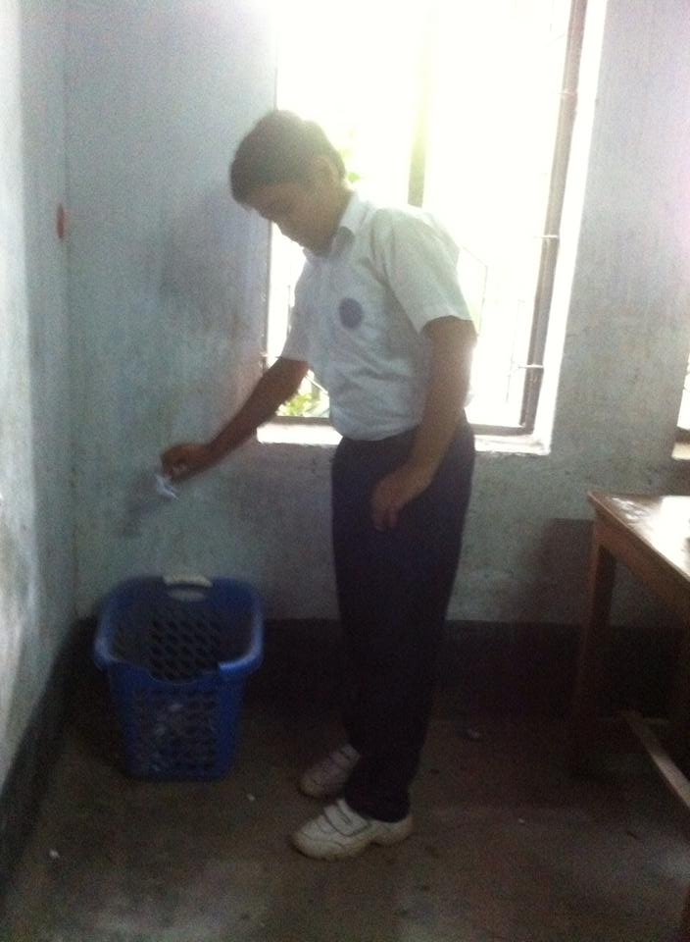
WELCOME
TO
ENG 1ST PAPER CLASS
CLASS VIII

Slide 2
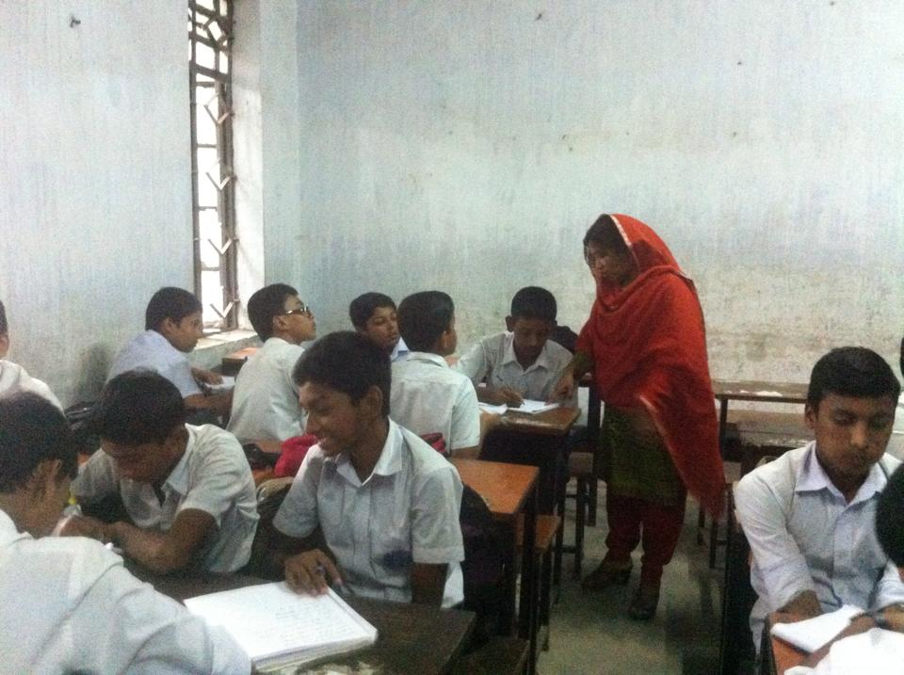
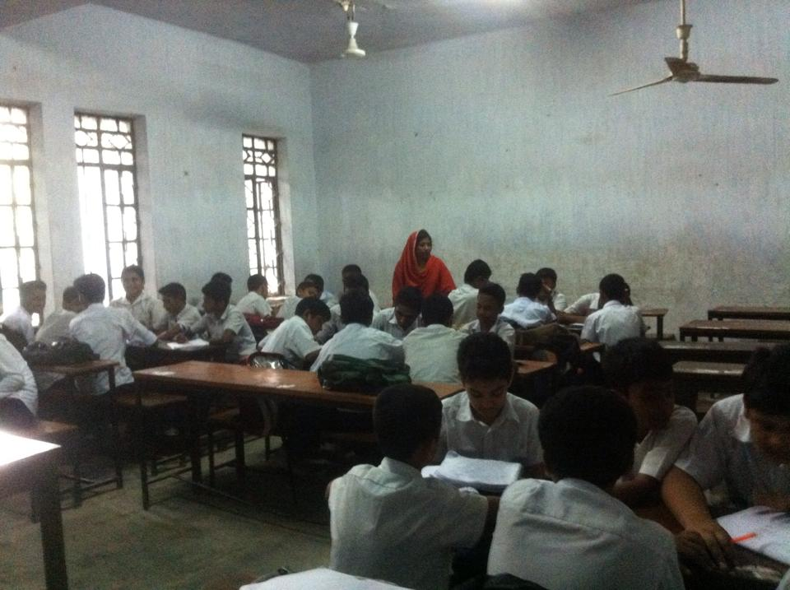

Slide 3
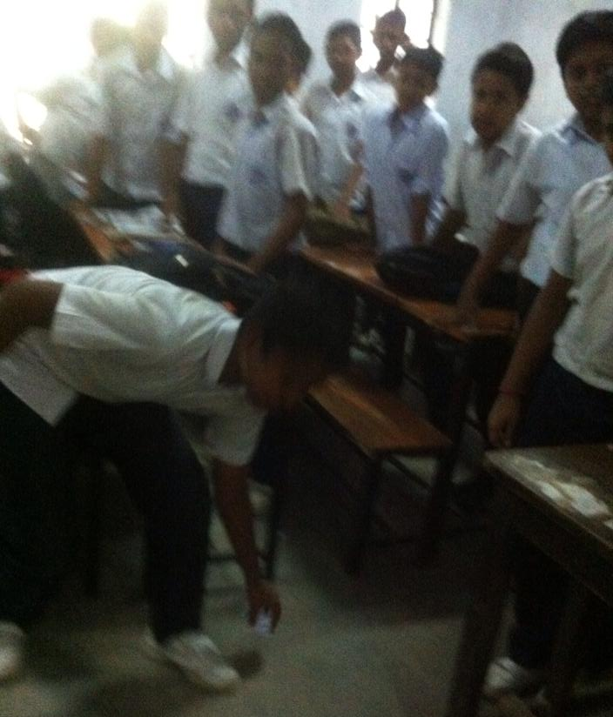
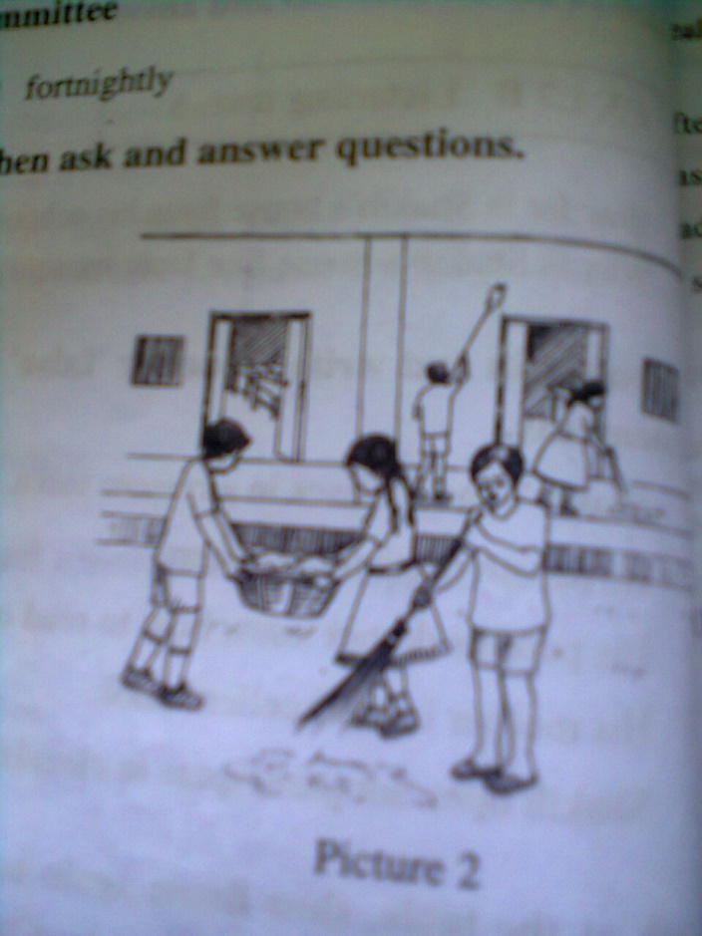
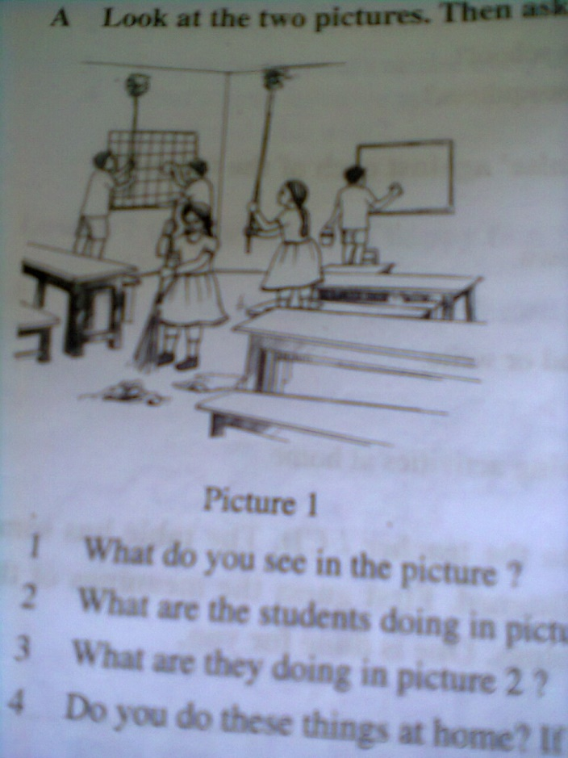
What can you see in the picture ?

Slide 4
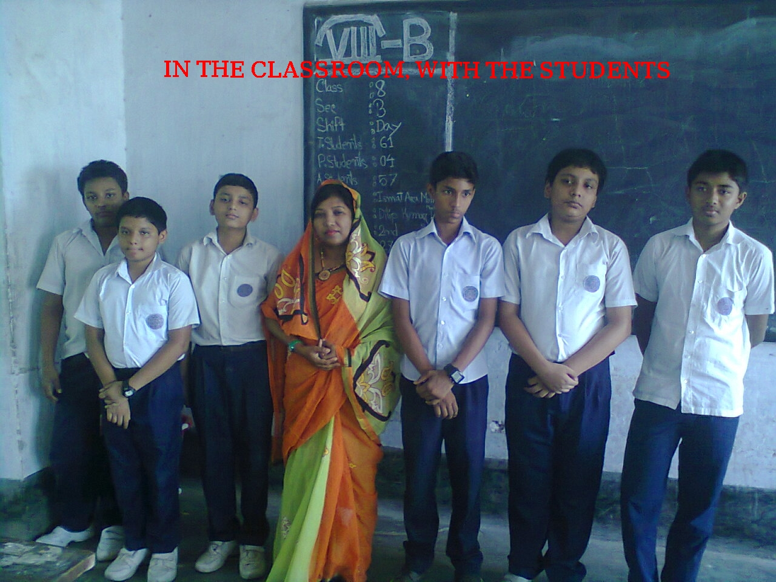
Today’s topic
With the class committee/forum leaders
6
Class forum / class committee

Slide 5
LEARNING OUTCOMES
By the end of the lesson the learners will be able to
*ask and answer questions
*read a passage understanding through silent reading
*make a committee/forum
*explain some rules of a committee/forum.

Slide 6
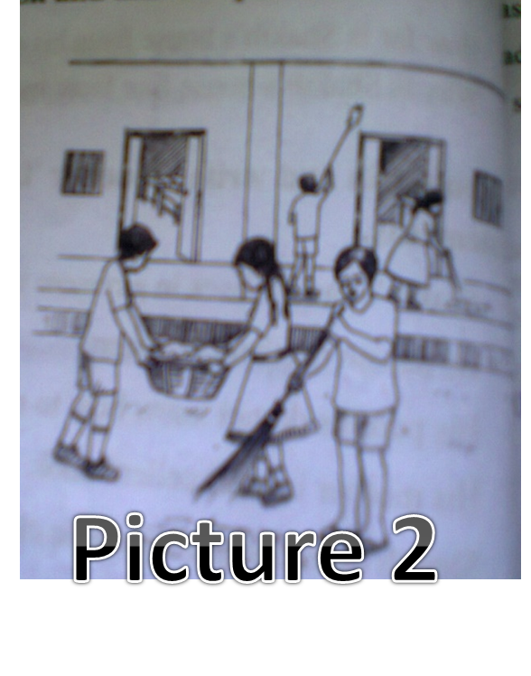
b. Text reading: the learners will be asked for
reading the passage
to answer the questions
Picture 1

Slide 7
A .Pair work:
Look at the two pictures .Then ask and answer
the following questions in pairs.
Picture 1
Picture 2
1.What do you see in the pictures?
2.What are the students doing in picture 1?
3.What are they doing in picture 2?
4.Do you do these things in your classroom or at home?
5.If you do not do so, do you know who does?

Slide 8
Forum/Committee
a discussion of a public issue or other serious topic by a select group.
The class 8 students have formed a class forum/committee
to keep their classroom clean.
Notes:
The learners will be invited to make sentences.

Slide 9
A class committee/forum
With the class committee/forum leaders
CLASS TEACHER
MEMBERS
CLASS CAPTAIN
A class committee/forum was formed by class 8 students under the leadership of their class captain with cordial co-operation of the class teacher.

Slide 10
(noun)
Synonyms: administration, management, directorship, control, governorship,,
the position or function
of a leader, a person who
guides or directs a group:
The learners will be
encouraged to make
sentences going
to the board

Slide 11
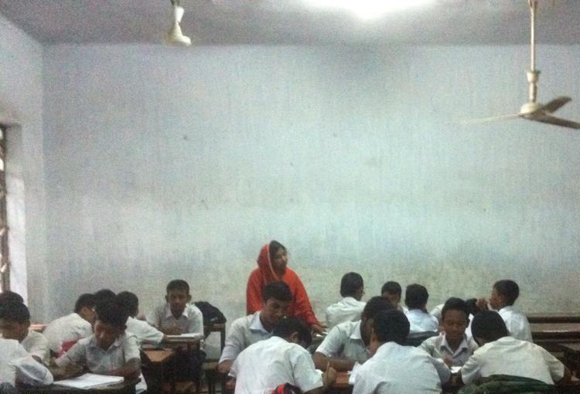
Environment
the aggregate of surrounding things, conditions, or influences; surroundings (textual meaning)
The environment of the classroom is favourable
for the learners.

Slide 12
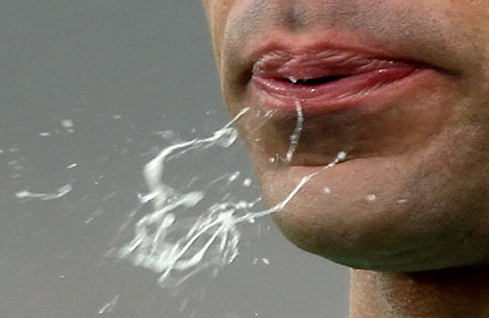
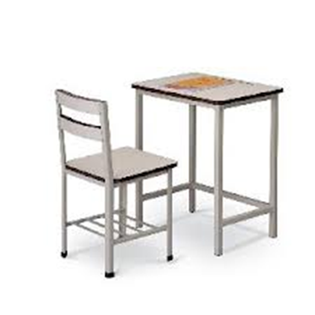
GROUP WORK
Make a work plan in the light of the 4 rules of the text for cleaning program at your won school. You will be divided into four groups. Each group will focus on 1 rule. Like 1—1, 2--2, 3---3 and 4----4.
1—1
2--2
3---3
4----4

Slide 13
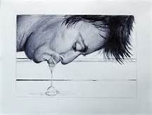
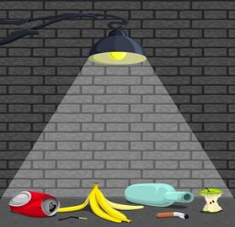
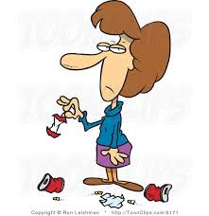
The students decided to make some ground rules.
Here is a list of some of the rules.
1. Do not spit on the class
to eject saliva from the mouth
2. Do not drop litter in the class
a disordered or untidy collection of
objects

Slide 14
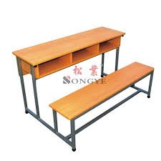
3.Use the bin for trash.
a worthless or discarded material
A container or enclosed space
for storage
4.Keep the desk and chair in place.

Slide 15
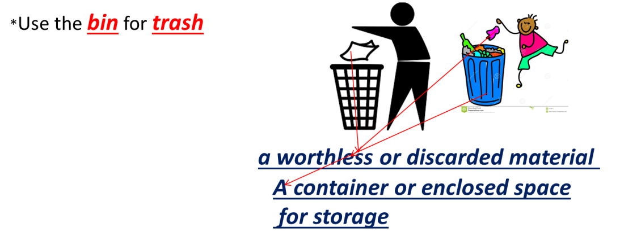
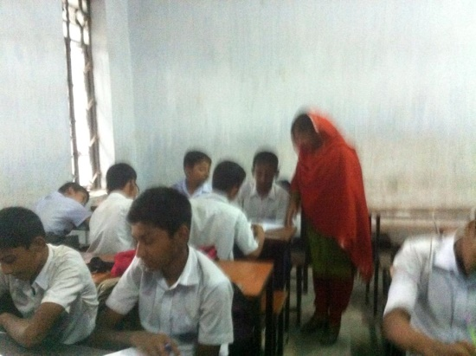
Indivisual Work
Answer the following questions..
1.What did the class teacher say to the students
of class 8?
2 How did the students make the class forum/
committee?
3.How did the students make a work plan?
4.What are the basic rules the students make ?

Slide 16
Choose the best answer
1.Ms,. Subarna Saha is
Physical education teacher
an English teacher
an Arabic teacher
d)the class teacher of class 8
2.The class teacher suggested the students to make a forum / committee
To keep their classroom tidy
to take part in social activities
to keep the school environment clean
to help each other
3. The students were happy to be able to
To become the members of the committee/ forum
participate in the cleaning program at school
make their class captain leader of the committee/ forum
enjoy the cleaning program

Slide 17
HOME WORK
Write the summary of the passage in 35- 40 words

Slide 18
Thank u very much, dear students

Slide 19
The teachers are requested to follow the notes given below the slides.
Note for the teachers: In this content , most of the words have been explained in vocab section.
If the teachers who will use the content in their own classroom may explain all the words if needed .

